Slide 1


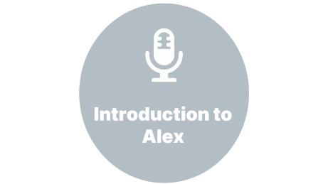
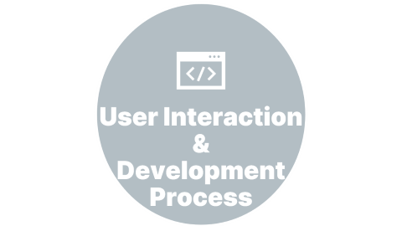




Slide 2

Introduction to Alex

Slide 3


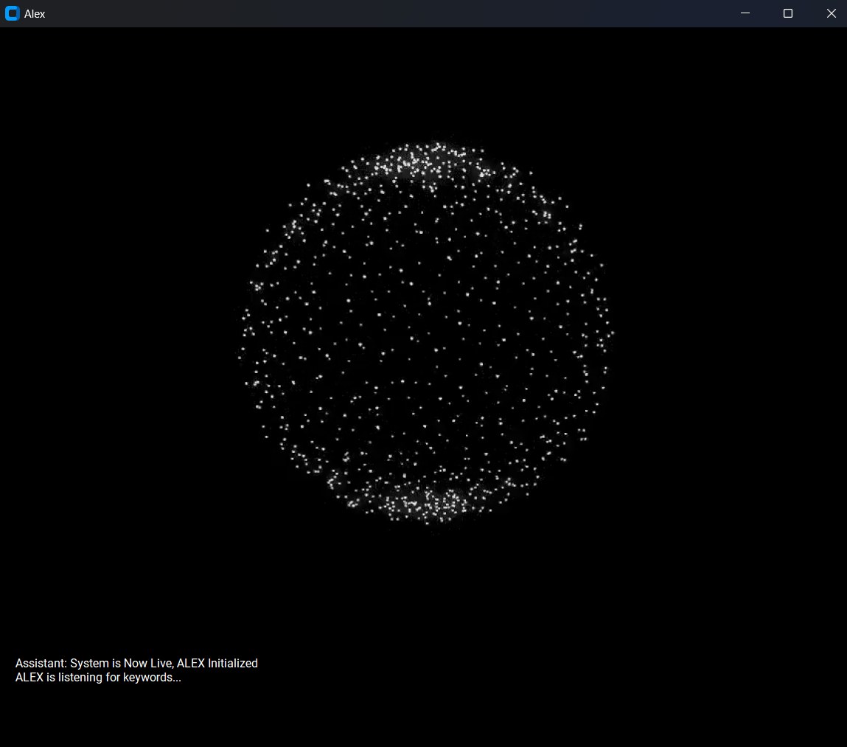
Introduction to Alex
:
A Voice Assistant for Linux
Alex is an innovative voice assistant designed specifically for Linux operating systems. Developed using Python, Alex offers users a hands-free, intuitive way to interact with their devices and access a variety of functionalities.

Slide 4

User Interaction &
Development Process

Slide 5


User Interaction &
Development Process
1
Initial Planning
Identified the need for a Linux voice assistant and outlined key
functionalities.
User Interaction
2
Users initiate interaction by saying "Alex," and then they can ask Alex to perform tasks.
3
Technical Implementation
Utilized Python, Vosk, and pyttsx3 to develop Alex, with multiple attempts to refine it.
4
Iterative Testing
Iterative testing to address bugs and enhance performance, though it's still a prototype.

Slide 6

Technologies Used

Slide 7


Technologies Used
1
Python
Alex is built on the robust and versatile Python programming language, ensuring reliable and efficient performance.
2
Vosk
The Vosk speech recognition model, a lightweight and offline-capable library, powers Alex's voice recognition capabilities.
3
Python Libraries
Python library that allows For custom GUI , video processing , image handling , concurrent operations , text-to-speech , speech recognition and Various custom modules for different operations (online_ops, os_ops, etc.).

Slide 8

Use Cases & Applications

Slide 9

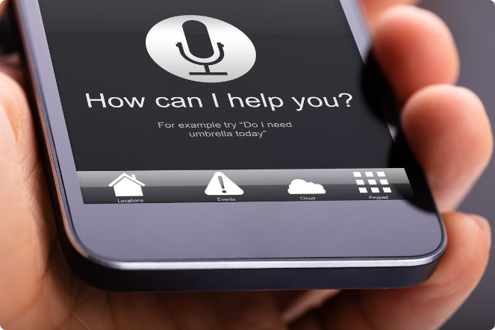
Use Cases & Applications
1
Opening and Closing Applications:
Alex allows users to open and close applications through voice commands, streamlining daily operations without the need to manually search for and launch applications.
Examples: "Alex, open the calculator," "Alex, close Firefox."
2
Web Searches:
Users can ask Alex to search the web on their behalf, saving time and effort.
Examples: "Alex, search for the weather in New Delhi," "Alex, look up the latest news on Google."
3
Media Control:
Alex can play videos on YouTube, making it easy to access multimedia content without using the keyboard or mouse.
Examples: "Alex, play a tutorial on Python programming on YouTube," "Alex, play relaxing music."
4
Multitasking:
Hands-Free Operation: Alex enables users to perform tasks while their hands are occupied, enhancing productivity.
Examples: Taking notes during a meeting while instructing Alex to set reminders or search for information.

Slide 10

Secure and Private

Slide 11


Secure and Private
User Control & Data Handling
Currently, Alex does not store user data, focusing on providing immediate responses to commands. Users have the ability to customize Alex's privacy settings .

Slide 12

Hands-Free Productivity

Slide 13

Hands-Free Productivity
Multitasking Made Easy
Increased Productivity
Accessibility for All
Alex enables users to juggle multiple tasks simultaneously, freeing their hands for other activities.
By automating common tasks and enabling hands-free control, Alex helps Linux users boost their overall productivity
Alex's voice-based interface makes it an ideal solution for users with disabilities or those who prefer a hands-free approach.

